Slide 1
HAN-ECG: An Interpretable Atrial Fibrillation Detection Model
Using Hierarchical Attention Networks
李安

Slide 2
Background
Question: The cardiologist level performance in detecting this arrhythmia is often achieved by deep learning-based methods, however, they suffer from the lack of interpretability.
The lack of interpretability is a common challenge toward a wide application of machine learning (ML)-based approaches in the healthcare which limits the trust of clinicians in such methods.

Slide 3
Background
Answer:HAN-ECG, an interpretable bidirectional-recurrent-neural-network-based approach for the AF detection task.
The HAN-ECG employs three attention mechanism levels to provide a multiresolution analysis of the patterns in ECG leading to AF.
The first level, wave level, computes the wave weights;
The second level, heartbeat level, calculates the heartbeat weights,
The third level, window (multiple heartbeats) level, produces the window weights in triggering a class of interest.
All learned representations at each level are interpretable and are able to show which parts of the input signal are the reasons to trigger an AF event

Slide 4
Background
Answer:
CSS:• Computing methodologies→Knowledge representation and reasoning; Neural networks; • Applied computing →Health informatics.
Dataset:MIT-BIH AFIB database and the PhysioNet Computing in Cardiology Challenge 2017 dataset

Slide 5
Contributions
•We propose an end-to-end hierarchical attention model that achieve the state-of-the-art performance with the capability of the interpretability.
• The proposed model provide a multi-level resolution interpretability (i.e., window by window (multiple heartbeats),heartbeat by heartbeat and wave by wave levels).
• We empirically demonstrate that the important parts of the ECG signal for the model in triggering the AF are clinically meaningful.
• The proposed approach can be used to recognize new poten_x0002_tial patterns leading to trigger life-threatening arrhythmias.

Slide 6
Methodology
•Pre-processing
a sequence of ECG heartbeats in which each heartbeat contains a sequence of building waves(P-wave, QRS complex, T-wave, etc.)
(1) Removing the baseline wander and power-line interference noises in the ECG signal.
(2) Transforming the given ECG signal values to have a zero mean and a unit standard deviation (i.e., standardization)
(3) Detecting the R-peaks of given ECG signal or detecting the QRS complexes using the PanâĂŞTompkins algorithm.
(4) Dividing the continuous ECG signal into a sequence of heartbeats, and split the heartbeats into distinct units named waves.

Slide 7
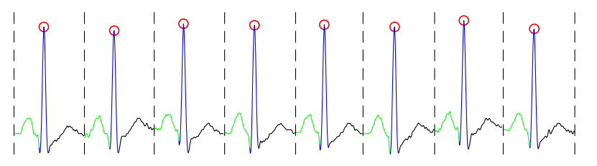
Methodology
•Pre-processing
Illustration of an ECG signal; The red circles indicate R peaks; green, blue and black curves illustrate P, QRS and T-waves, respectively.

Slide 8
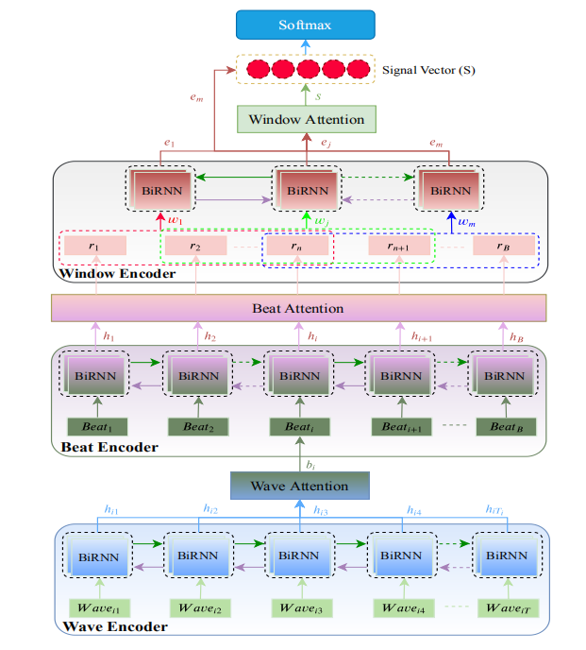
Methodology
•Model
the model architecture is composed of three mainparts:
a wave encoder along with a wave attention,
a beat encoderalong with a beat attention，
a window encoder along with a window attention.

Slide 9
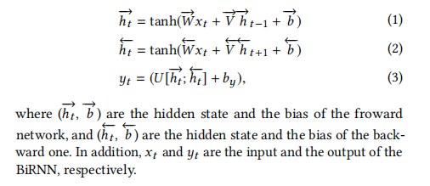
Methodology
•Model-Bidirectional Recurrent Neural Networks
BiRNN can process data in both forward and backward directions. Therefore, the current state has access to previous and next input information simultaneously.

Slide 10
Methodology
•Model-Wave Encoder and Wave Attention
A sequence of waves, wave_{it} t ∈ [1,T_{i}], for i^{th} heartbeat, is fed into BiRNN to encode the wave sequence. The forward network of the BiRNN gets the heartbeat, i in a normal time order of waves from wave_{i1} towave_{iT} and the backward network gets the heartbeat, i in a reverse time order of waves from wave_{iT} to wave_{i1}. Then, the BiRNN outputs, h_{it} representing a low dimensional latent vector representation of the heartbeat, i.

Slide 11
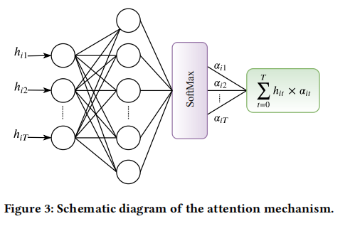

Methodology
•Model-Wave Encoder and Wave Attention
all waves of a heartbeat do not have the same weights in representing the heartbeat. Therefore, an attention mechanism is able to extract the relevant waves of the heartbeat that contribute more to the meaning of the heartbeat.

Slide 12

Methodology
•Model-Beat Encoder and Beat Attention
the BiRNN of the beat encoder part takes a sequence of wave context vectors, b_{i} (i ∈ [1, B]) as input and produces vectors, h_{i} (i ∈ [1, B]) which are latent representations of the input heartbeats. To put emphasise on the more important heartbeats in triggering the arrhythmia, another attention mechanism is used on the heartbeat level.

Slide 13
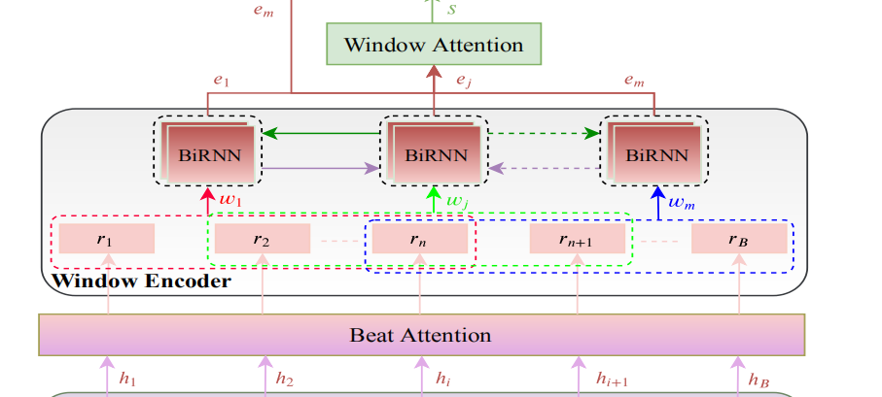

Methodology
•Model-Window Encoder and Window Attention
we also consider a window level encoding module in which a window contains multiple heartbeats.The heartbeat context vectors,(r1,r2, . . . ,rB) are converted to a sequence of windows,

Slide 14


Methodology
•Model-Detection
concatenate the window context vector, s and the last hidden state, em, to obtain a combined information of both vectors and then feed it into a shallow network followed by a softmax layer to produce a probability vector, p in which each element determines the probability of the input signal belonging to each class of interest(AF or non-AF)

Slide 15
Methodology
•Model-Interpretation
The proposed method has threelevels of the attention mechanism:
the first level (i.e., the wave level)produces the wave weights, α_{it} (t = 1, 2, ...,T_{i}) representing the importance of the waves in a heartbeat
the second level (i.e., theheartbeat level) computes the heartbeat weights, α_{i} (i = 1, 2, ..., B)showing the amount of the influence of each heartbeat on the occurrence of an arrhythmia,
third level (i.e., the window level)produces the window weights, γ_{j} (j = 1, 2, ...,m) demonstratingthe importance of the combinations of the heartbeats.

Slide 16
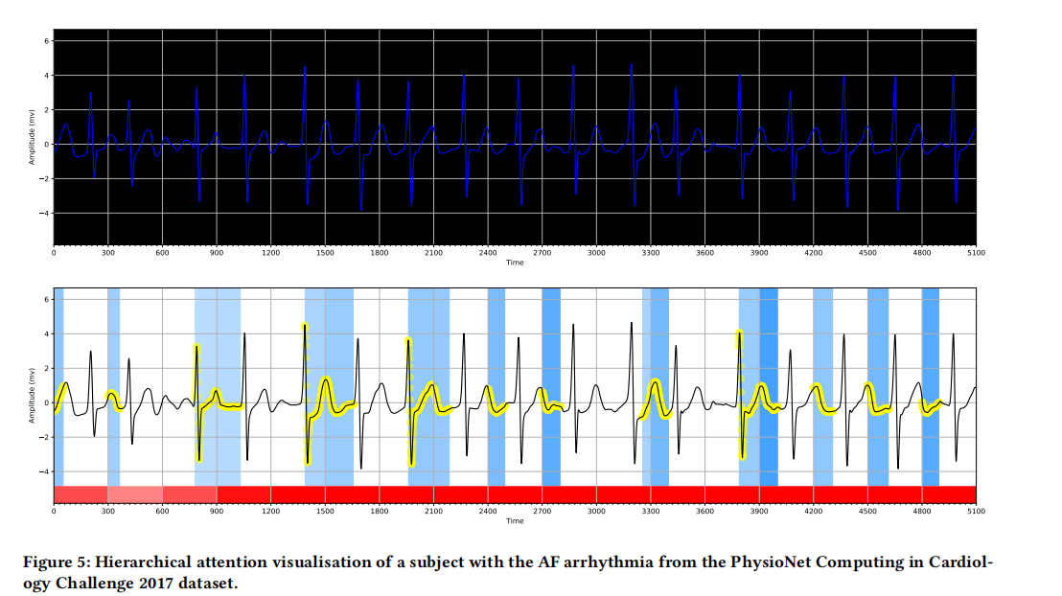
Methodology
•Model-Interpretation

Slide 17
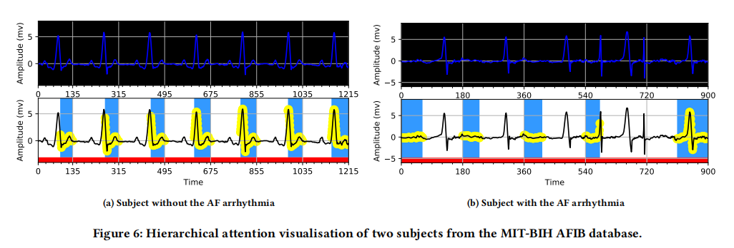
Methodology
•Model-Interpretation

Slide 18
Experimental Setup
•The proposed approach is based on the hierarchical attention networks and has employed three levels of attention. To show the performance of this proposed model, in our experiments, we consider the model without the attention mechanism (denoted as RNN containing just the BiRNNs), one- (denoted as HAN-ECG1), two-(denoted as HAN-ECG2) and three- levels (denoted as HAN-ECG3) of the attention mechanism.
•Applied a 10-fold cross-validation approach to evaluate the model.
•The models were trained with a maximum of 25 epochs and mini-batches of size 64.
•The Adam optimizer was used to minimize the loss, L with a learning rate α = 0.001. A drop-out technique with a probability of dropping of 0.5 to reduce the effect of the overfitting problem during the training. The number of layers for the BiRNNs ware set to 2.

Slide 19
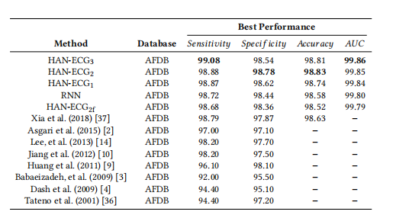
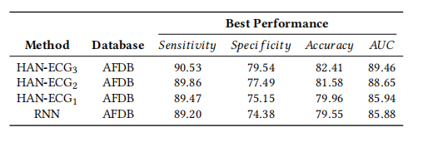
Results

Slide 20
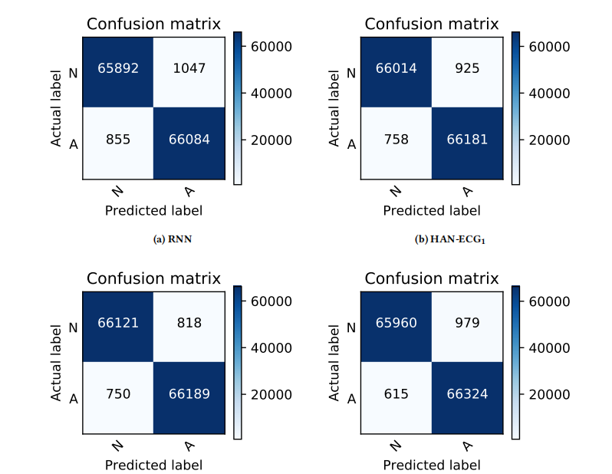
Results

Slide 21
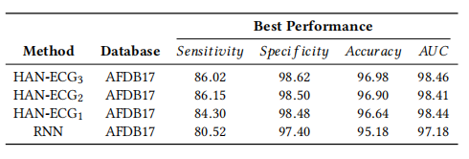
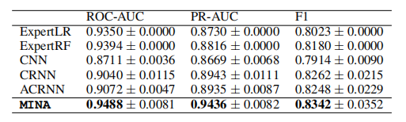
Results
HAN-ECG: An Interpretable Atrial Fibrillation Detection Model Using Hierarchical Attention Networks
MINA: Multilevel Knowledge-Guided Attention for Modeling Electrocardiography Signals

Slide 22
THANK YOU

